Slide 1

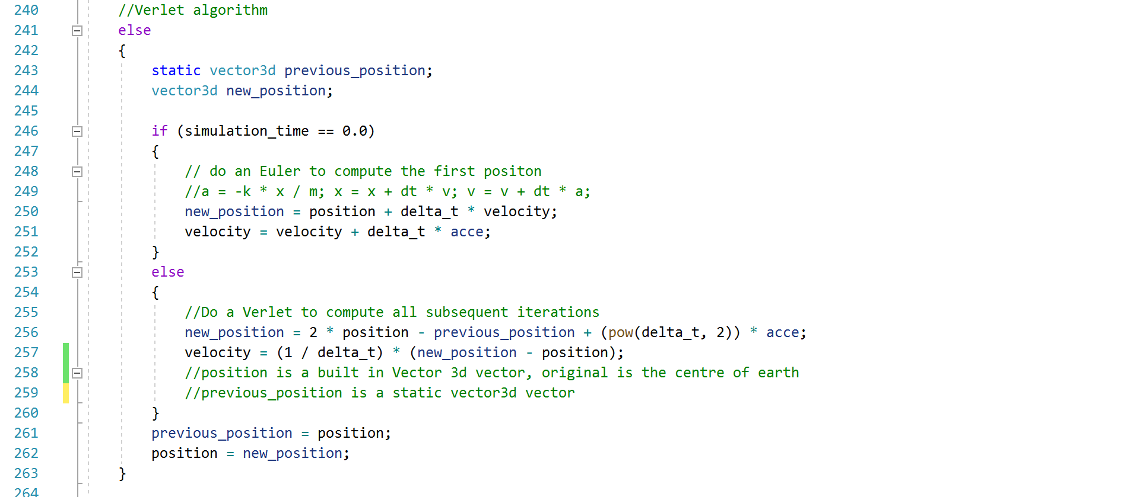

Numerical method

Slide 2
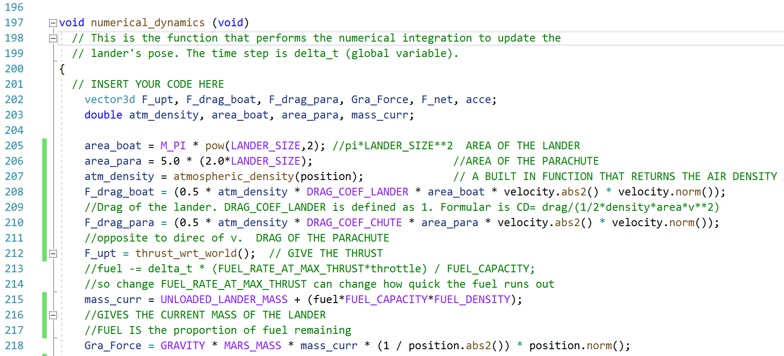

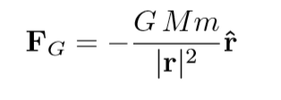
Numerical dynamics in three dimensions
Note: I didn’t compute the attitude dynamics of the lander. But I am very interested in doing some research in that area

Slide 3
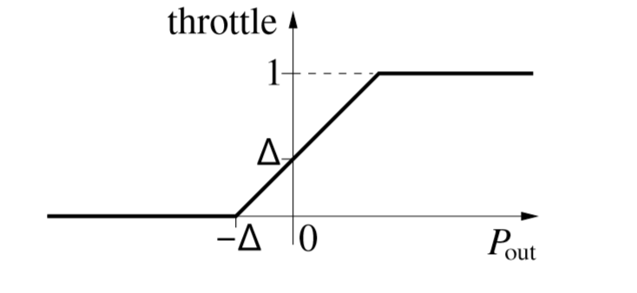









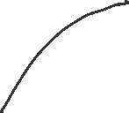
Automatic landing
e(s) = -(0.5+$K_{h}$h) –v.er

Slide 4
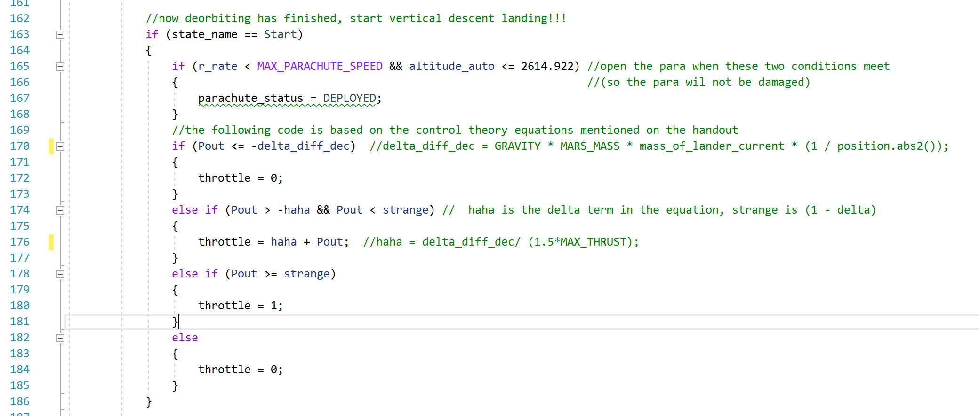

Automatic landing
Notes:
On the graph, the slope is 45 degrees. Throtthle = haha+ Pout

Slide 5
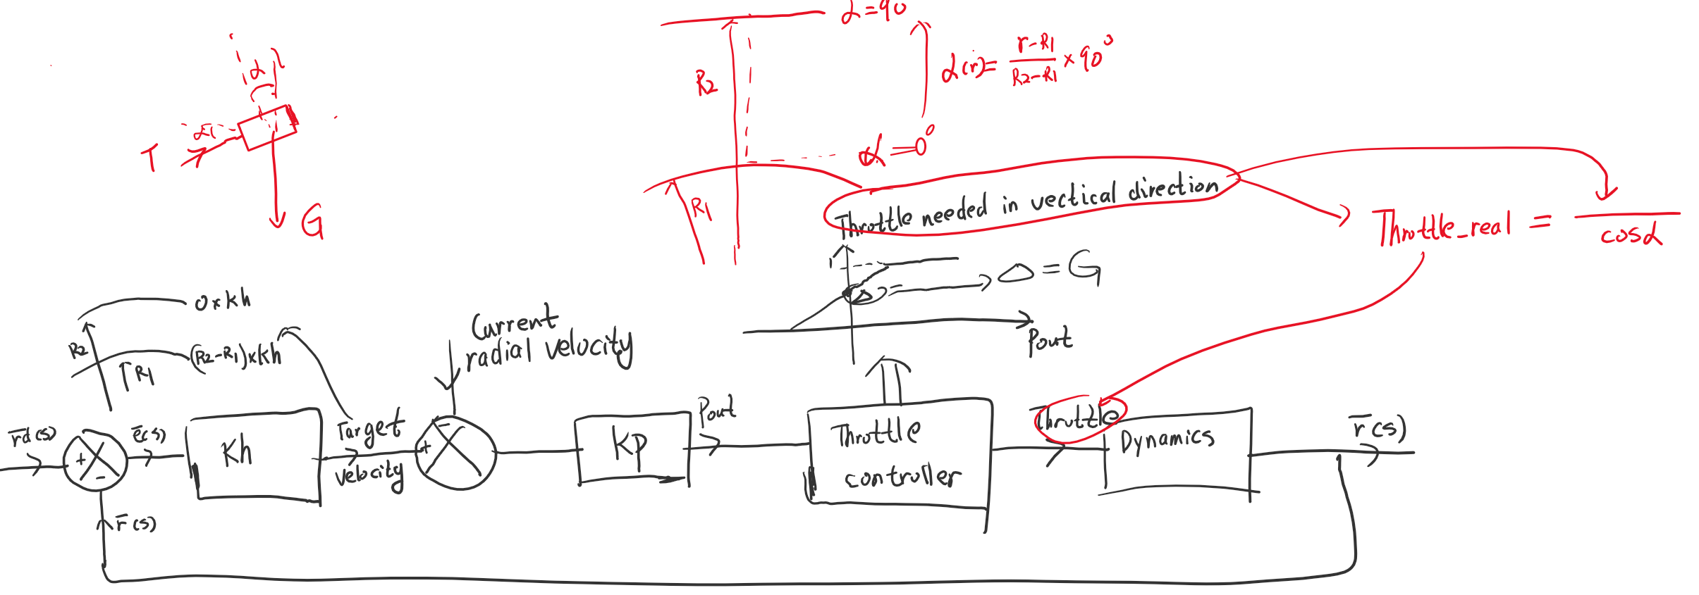
Automatic orbit insertion

Slide 6
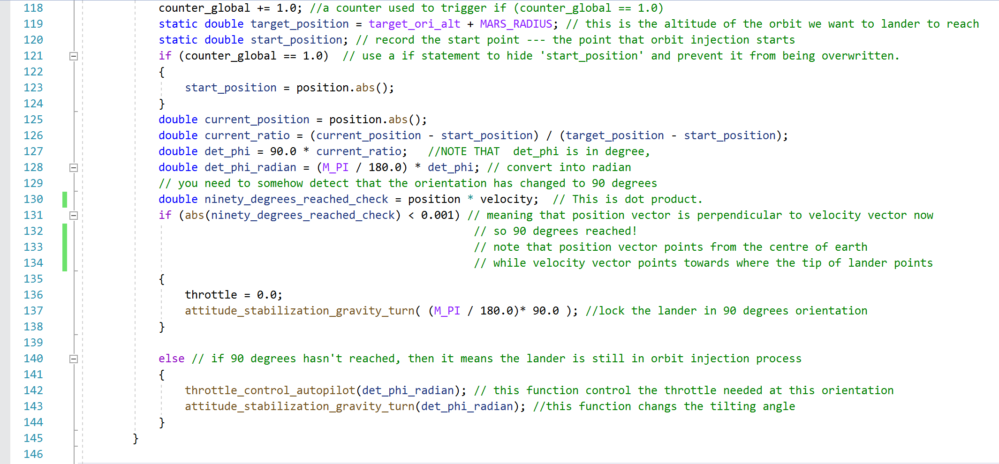
Automatic orbit insertion

Slide 7
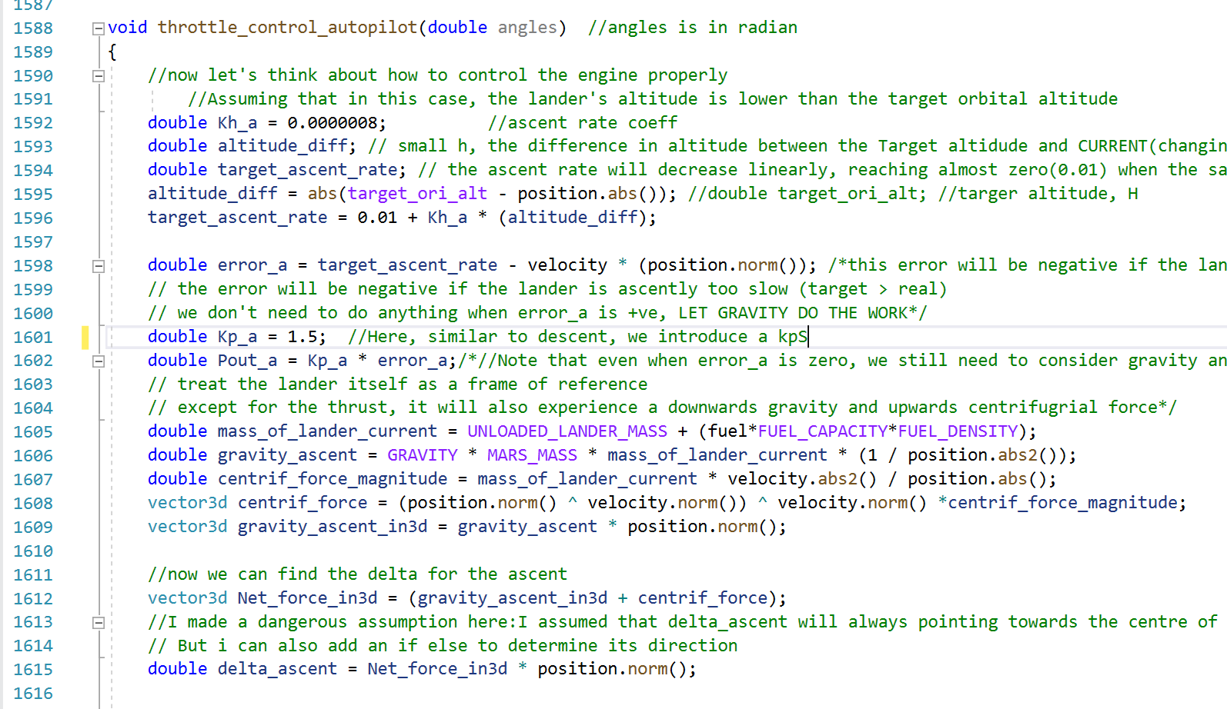

Slide 8
